Slide 1

Monitoring Humidity and Temperature using Bluetooth and WIFI module via Android device.
BS PROJECT
Bhargav Petla (18070)

Slide 2
Motivation
1. Environmental changing conditions
Alerting of any changes to the climate conditions
2. Industrial use
Measurement and maintaining constant temperature are also important in industrial processes.
3. Temperature transducers
which are used in electrical measurements are numerous due to a wide range of temperatures being measured, and because of the measurement accuracy in a specific area

Slide 3
DHT 11
DHT11 Temperature & Humidity Sensor features a temperature & humidity sensor complex with a calibrated digital signal output. By using the exclusive digital-signal-acquisition technique and temperature & humidity sensing technology, it ensures high reliability and excellent long-term stability.
The DHT11 detects water vapor by measuring the electrical resistance between two electrodes. The humidity sensing component is a moisture holding substrate with electrodes applied to the surface. When water vapor is absorbed by the substrate, ions are released by the substrate which increases the conductivity between the electrodes. The change in resistance between the two electrodes is proportional to the relative humidity. Higher relative humidity decreases the resistance between the electrodes, while lower relative humidity increases the resistance between the electrodes.
The DHT11 measures temperature with a surface mounted NTC temperature sensor (thermistor) built into the unit.

Slide 4
Range Values
Humidity Range: 20-90% RH
Humidity Accuracy: ±5% RH
Temperature Range: 0-50 °C
Temperature Accuracy: ±2% °C
Operating Voltage: 3V to 5.5V

Slide 5
Objective
01
Hardware Representation
02
Coding
Creating Mobile App using MIT APP inventor
03

Slide 6
Materials
Arduino Board
HC-05 Bluetooth module
DHT11 Sensor
MIT app inventor
LCD Display

Slide 7
Methodology
Hardware | Coding | MIT inventor | Android APP
Sending DHT-11 data to android Using HC-05 Bluetooth module. | Coding in Arduino IDE and uploading them to Arduino. | Creating an APP to receive data from Arduino. | Receive data from Arduino through Bluetooth.

Slide 8
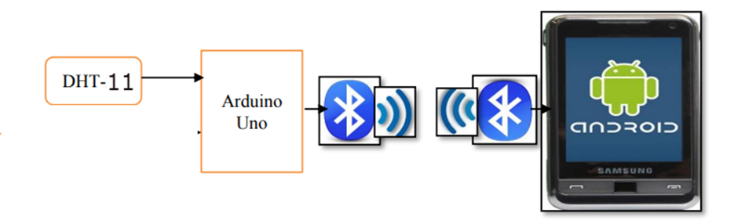
Methodology

Slide 9
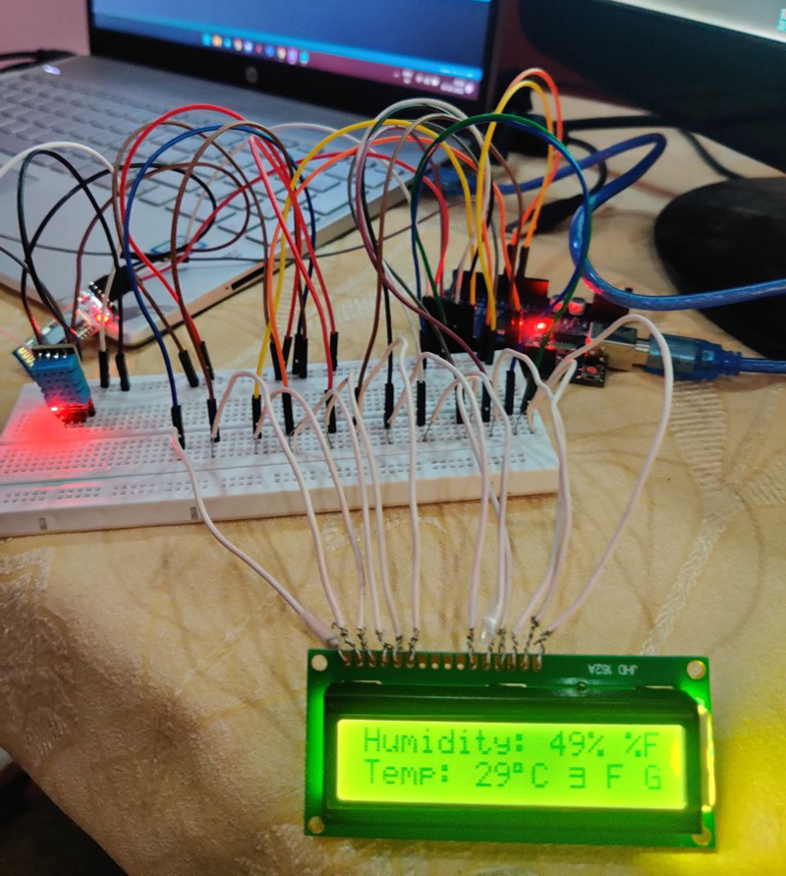
Hardware Representation

Slide 10
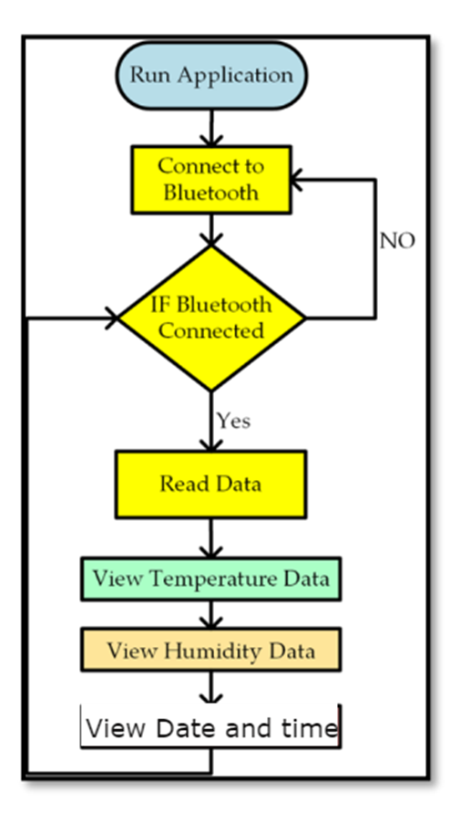
MIT App inventor

Slide 11
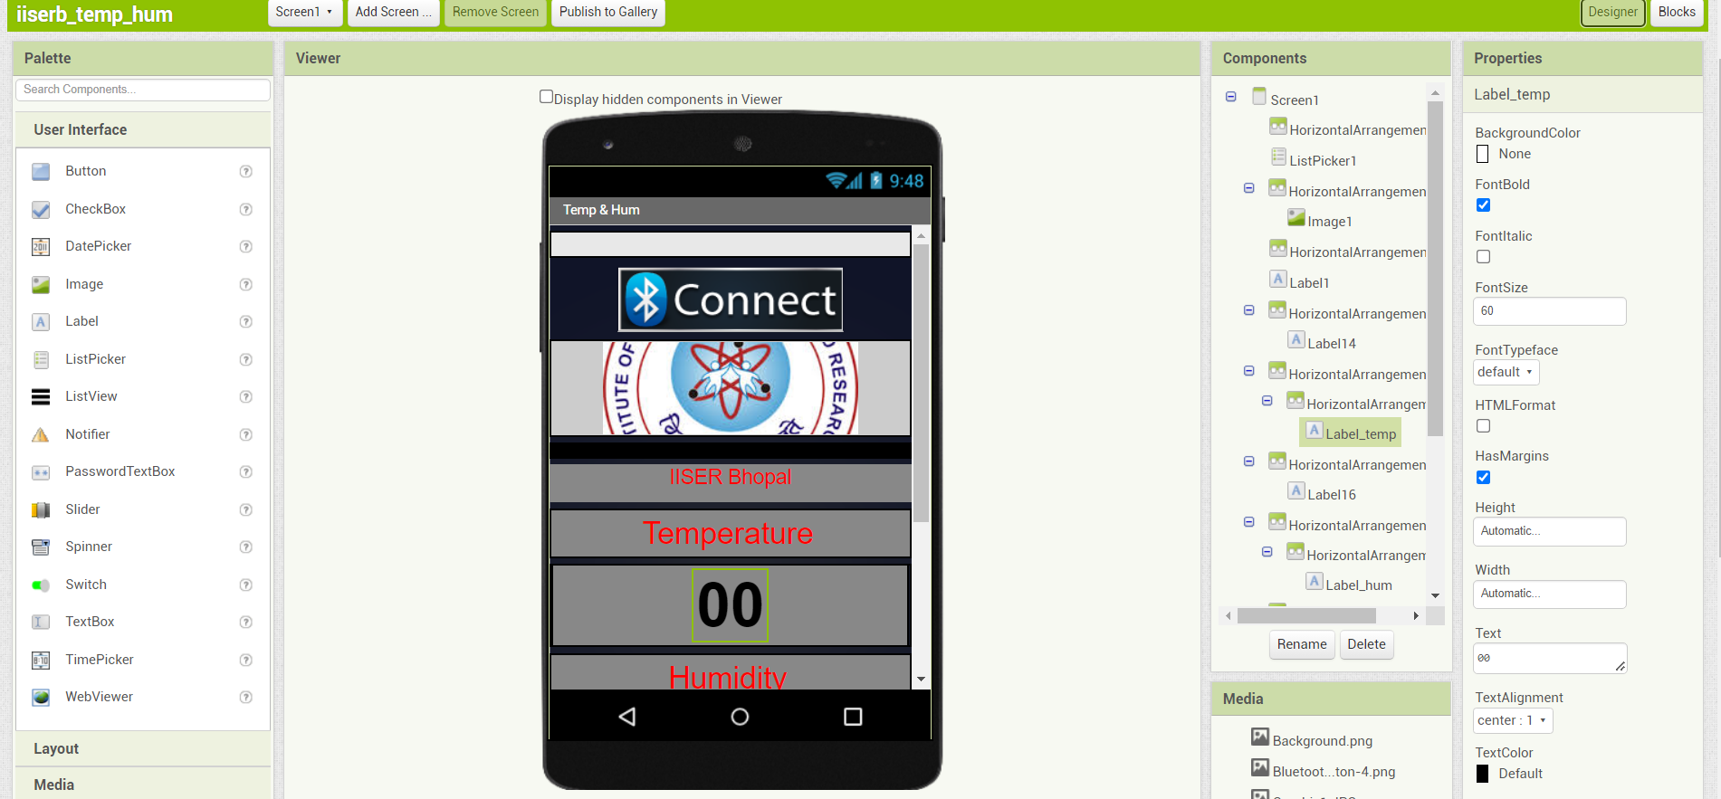
MIT App inventor

Slide 12
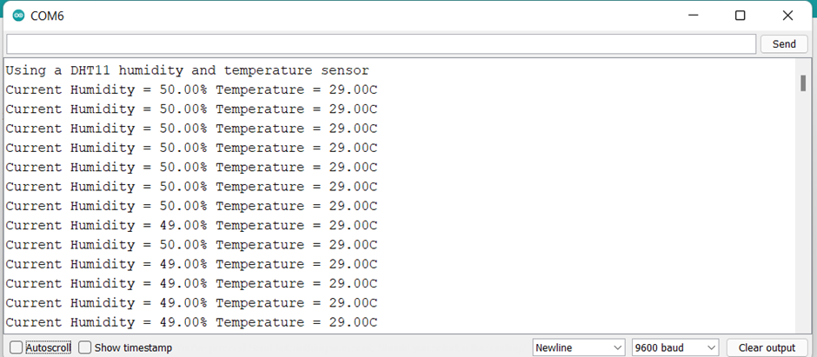
Results

Slide 13
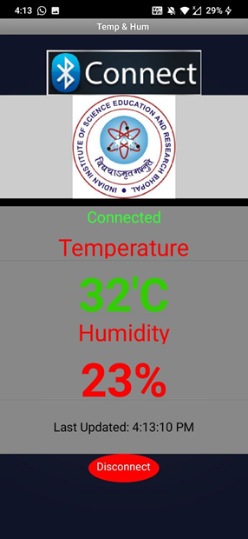
Results Of Android App

Slide 14
References
[1]https://create.arduino.cc/projecthub/tehcwan_canel/temp-humidity-dht11-weather-monitoring-in-mobile-app-57b5ac
[2] https://www.mouser.com/datasheet/2/758/DHT11-Technical-Data-Sheet-Translated-Version-1143054.pdf
[3] https://iotdesignpro.com/projects/temperature-humidity-monitoring-over-thingspeak-using-arduino-esp8266
[4]https://www.researchgate.net/publication/352914267_On_the_Evaluation_of_DHT22_Temperature_Sensor_for_IoT_Application
[5] https://www.researchgate.net/publication/334207536_Humidity_and_temperature_monitoring
[6] https://www.academia.edu/download/58144752/IRJET-V5I12167.pdf
[7] http://ijrar.com/upload_issue/ijrar_issue_20543685.pdf
[8] https://link.springer.com/chapter/10.1007/978-981-15-6707-0_53

Slide 15
Thank You

